Slide 1
For Live Session Assignment (FLS)
Unit 7

Slide 2
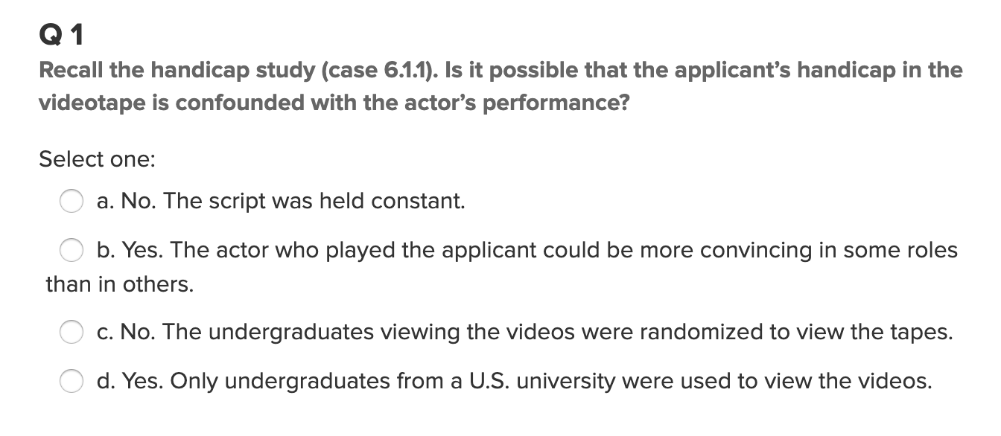
Question 1

Slide 3
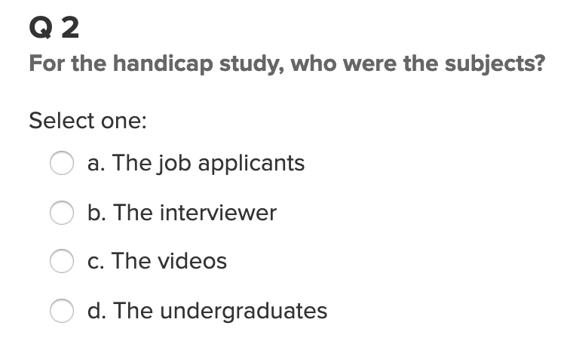
Question 2

Slide 4
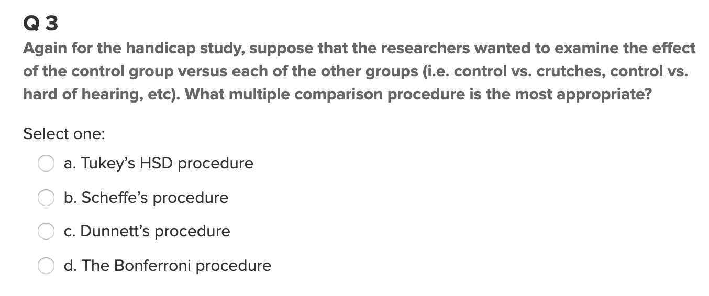
Question 3

Slide 5
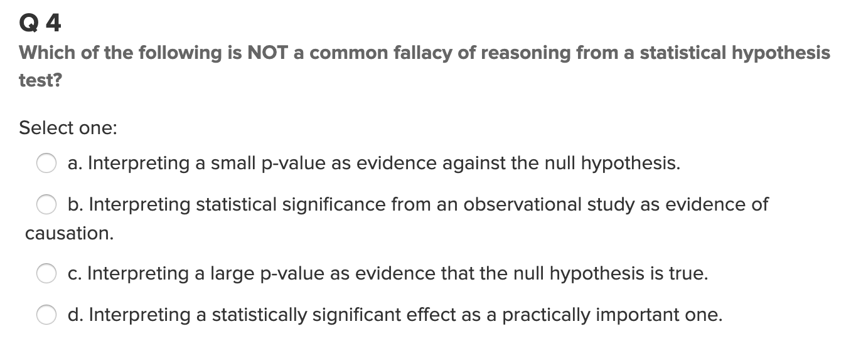
Question 4

Slide 6
Contrasts
We found in the last Unit that there was overwhelming evidence that at least one pair of sports had different mean heights. We ran the extra sum of squares test to find if there was significant evidence to suggest that the mean height of basketball players was different than that of the other sports. Another method to test for this difference is with a contrast. Create a contrast to test to see if there is evidence that that mean height of basketball players is significantly different than the average of the mean heights of the other 4 sports.
Your response should be neat, organized and thorough. Please include the code you used to generate your results as well as a conclusion statement that is written in non technical terms (but include the pvalue and a confidence interval).

Slide 7
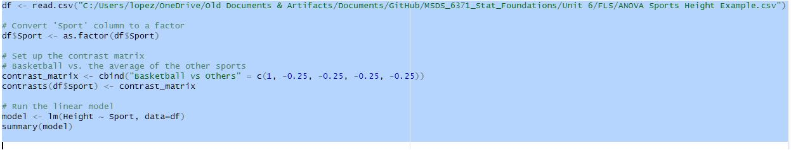
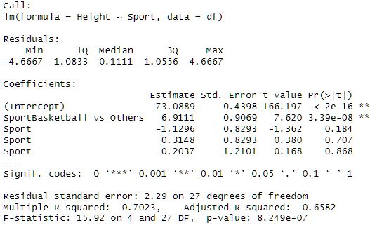
Contrasts

Slide 8
Contrasts
Scope inference:
It was clear basketball athletes were much taller than other sport athlete.
Contrasts confirmed the findings from the other tests.
I consider the F-statistic to be rather large; hence, confirming the large difference of the basketball players in regards to the other sports players.
With the p-value being much smaller than the alpha (.05), then the contrasts are statistical significant, which also confirms the evidence to reject the null hypothesis.

Slide 9
Multiple Comparisons: Break Out
We found in the last Unit that there was overwhelming evidence that at least one pair of sports had different mean heights. We ran the extra sum of squares test to find if there was significant evidence to suggest that the mean height of basketball players was different than that of the other sports. This time, let’s run every pairwise t-test and perform the appropriate multiple comparison adjustment and see if these results agree with the extra sum of squares test!

Slide 10
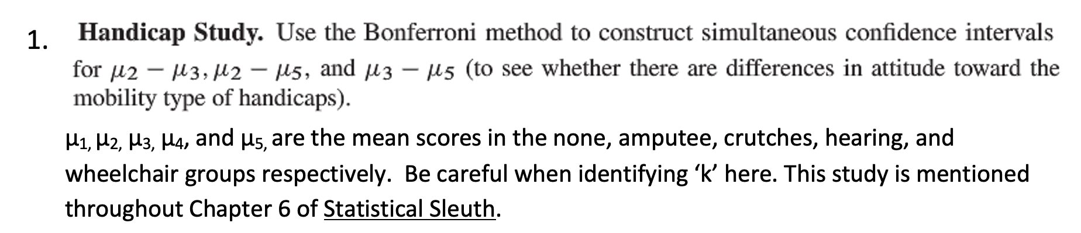
HW Problem

Slide 11
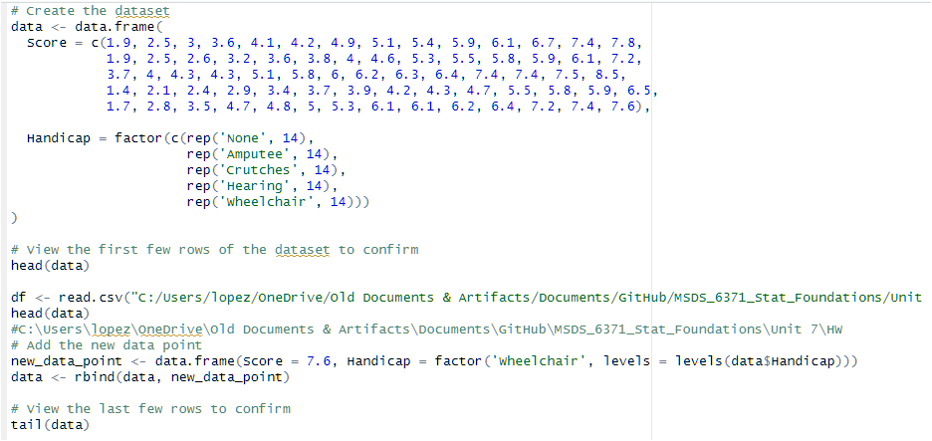
Handicap

Slide 12
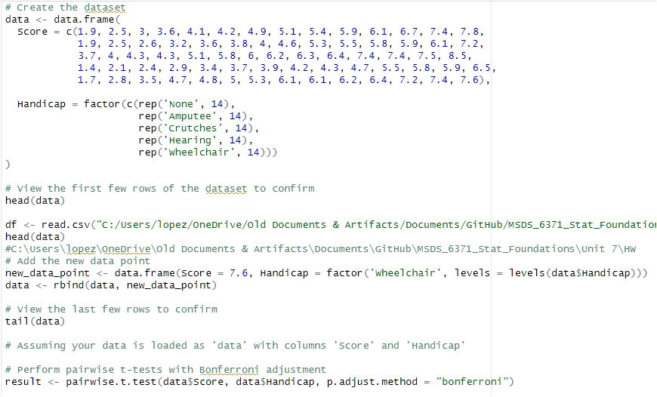
Handicap

Slide 13
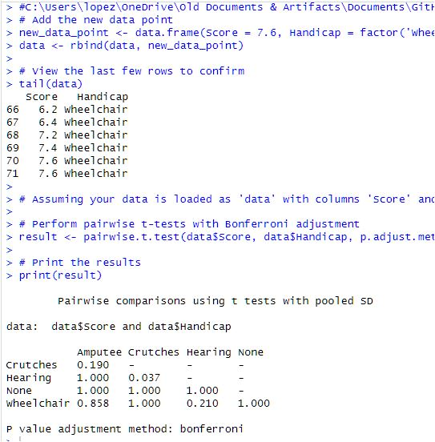
Handicap

Slide 14
Handicap
In the rating results, one can see that hearing and the non-impaired rated the same. However, the differences were not that greatly different.
My only inference is that the hearing and non-impaired did not have visible handicaps and maybe that is why they were rated as such.

Slide 17
Question 4: Takeaways!
Please provide at least 4 takeaways from this section and any questions that you may have. These questions will help design the live session for this unit.
- Was the point of this exercise to do the Tukey’s test for the heights? Because it was clear to me from the get-go, Basketball had the taller athletes; however, I also draw from watching sports those are some of the tallest players on average.
- I understand we do not get the full story on the control group (non-handicapped) as to why they were necessarily scored as they did; but the hearing was also scored the similar way, which makes me think, is it because they couldn’t see the handicap as much as the other ones as a “visually” impaired?
I also did not understand the finding of ‘k’.

